Slide 1


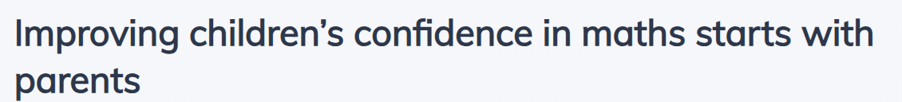
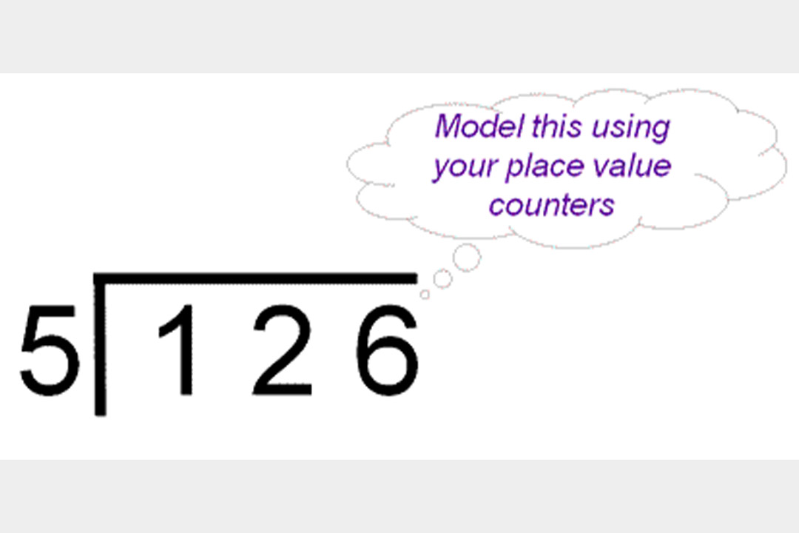
MATHS MASTERY 07.10.25
PARENTS’ ADDITION AND SUBTRACTION SESSION
(National Centre for Excellence in the Teaching of Mathematics, 2019
https://www.ncetm.org.uk/features/improving-children-s-confidence-in-maths-starts-with-parents/ )
Use place value counters to model what is actually happening in this short division algorithm.
https://www.nationalnumeracy.org.uk/helping-children-maths

Slide 2
THE ESSENCE OF MATHS TEACHING FOR MASTERY
Maths teaching for mastery rejects the idea that a large proportion of people just ‘can’t do maths’.
All pupils are encouraged by the belief that by working hard at maths they can succeed.
Pupils are taught through whole-class interactive teaching, where the focus is on all pupils working together on the same lesson content at the same time. This ensures that all can master concepts before moving to the next part of the curriculum sequence, allowing no pupil to be left behind.

Slide 3
THE ESSENCE OF MATHS TEACHING FOR MASTERY
In a typical lesson pupils the teacher leads back and forth interaction, including questioning, short tasks, explanation, demonstration, and discussion.
Procedural fluency and conceptual understanding (understanding what you are doing and knowing how to do it) are developed in tandem because each support the development of the other.

Slide 4
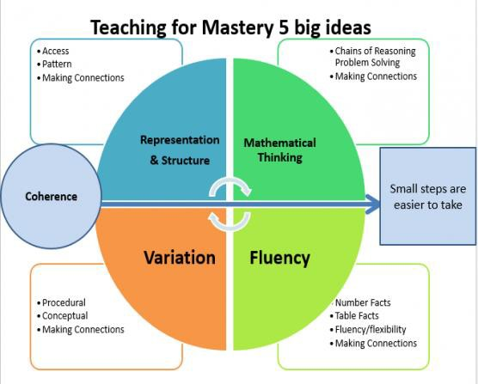
How do we teach Maths Mastery at Ditchling?

Slide 5
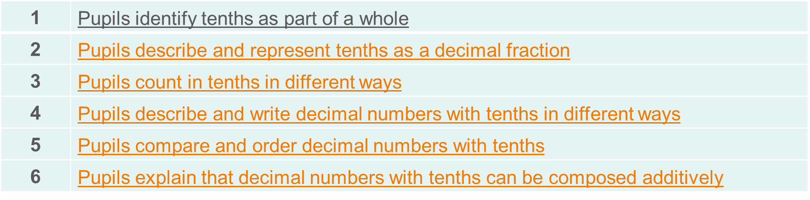
COHERENCE (BIG IDEA 1)
Lessons are broken down into small connected steps that gradually unfold the concept, providing access for all children and leading to a generalisation of the concept and the ability to apply the concept to a range of contexts (NCETM, 2019).
We use NCETM materials. The sequence of teaching is on the Maths page of the school website, and is also detailed on the Weekly Update.

Slide 6
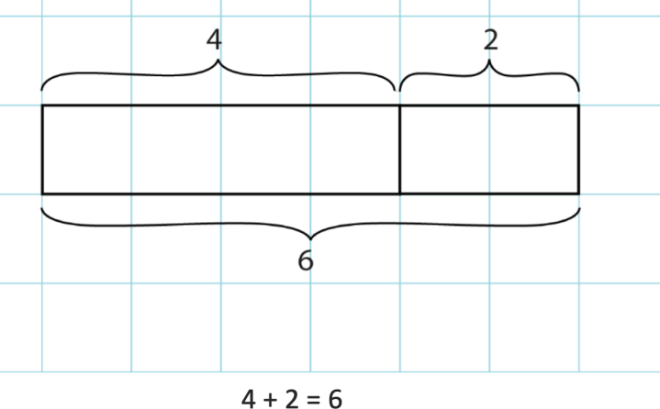
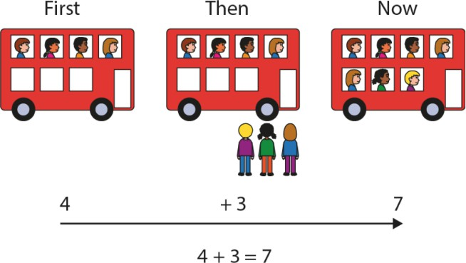
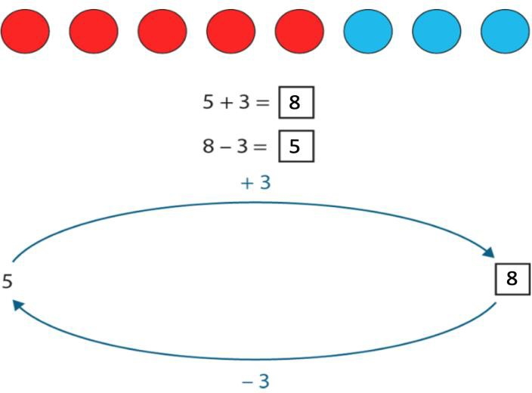
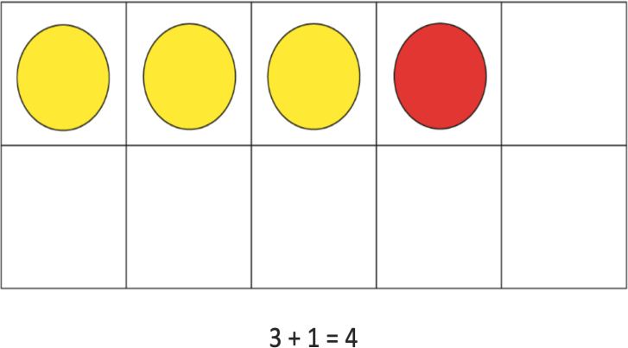
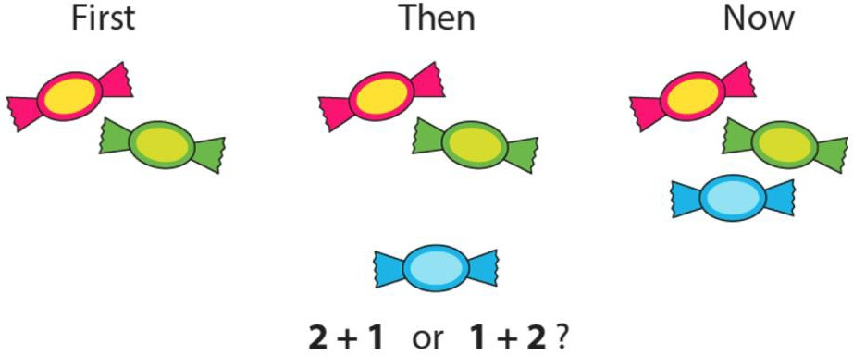
REPRESENTATION AND STRUCTURE (BIG IDEA 2)
Representations used in lessons expose the mathematical structure being taught, the aim being that students can do the maths without recourse to the representation (NCETM, 2019).

Slide 7
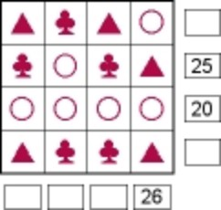
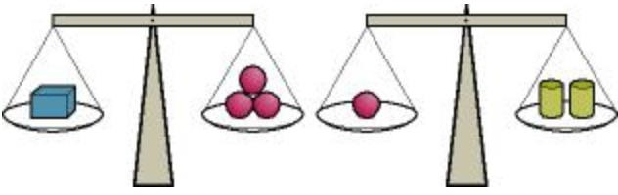
MATHEMATICAL THINKING (BIG IDEA 3)
If taught ideas are to be understood deeply, they must not merely be passively received but must be worked on by the student: thought about, reasoned with and discussed with others (NCETM, 2019).
Each shape stands for a number. The numbers shown are the totals of the line of four numbers in the row or column. Find the remaining totals.
From the information shown on the scales, can you work out which object weighs the least?

Slide 8
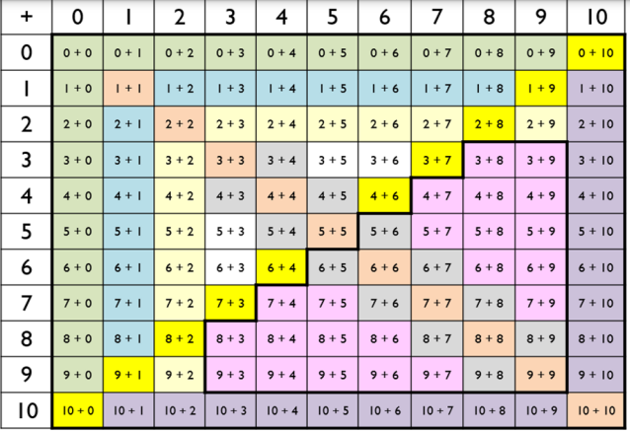
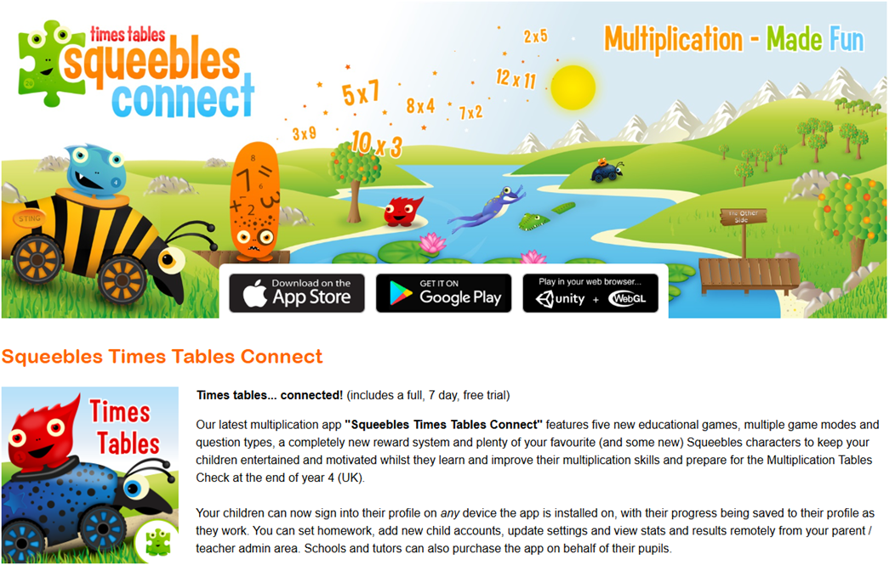
FLUENCY (BIG IDEA 4)
Quick and efficient recall of facts and procedures and the flexibility to move between different contexts and representations of mathematics (NCETM, 2019).
The National Curriculum states that pupils should become fluent in the fundamentals of mathematics through varied and frequent practice. While a part of this is about knowing key mathematical facts and recalling them efficiently, fluency means so much more than this.
Fluency gives pupils the ability to delve deeper into maths; to develop number sense and choose the most appropriate method for the task at hand; to be able to apply a skill to multiple contexts (Third Space Learning, 2019).

Slide 9

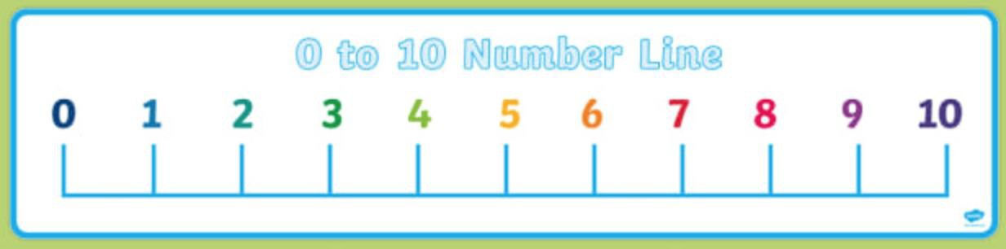
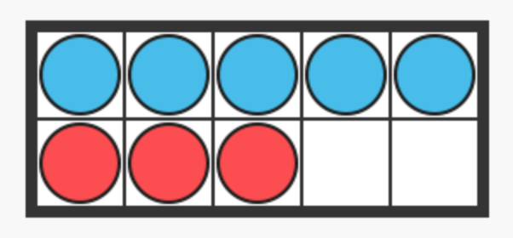
VARIATION (BIG IDEA 5)
Variation is twofold. It is firstly about how the teacher represents the concept being taught, often in more than one way, to draw attention to critical aspects, and to develop deep and holistic understanding. It is also about the sequencing of the episodes, activities and exercises used within a lesson and follow up practice, paying attention to what is kept the same and what changes, to connect the mathematics and draw attention to mathematical relationships and structure (NCETM, 2019).
There are 3 red flowers and 5 blue flowers. How many flowers are there altogether?
There are 8 flowers; some are red and some are blue. If three of them are red, how many are blue?
There are 8 flowers; some are red and some are blue. If there are two more blue flowers than red flowers, how many are there of each colour?

Slide 10

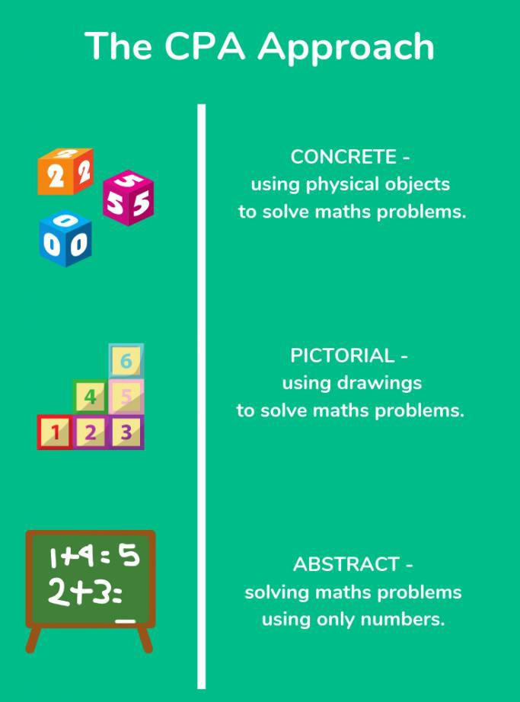
ANOTHER ASPECT OF MASTERY: CONCRETE – PICTORIAL – ABSTRACT
Concrete, Pictorial, Abstract (CPA) is a highly effective approach to teaching that develops a deep and sustainable understanding of maths in pupils.
CPA was developed by American psychologist, Jerome Bruner. It is an essential technique within maths mastery teaching.
This approach is used from Reception through to Year 6.

Slide 11
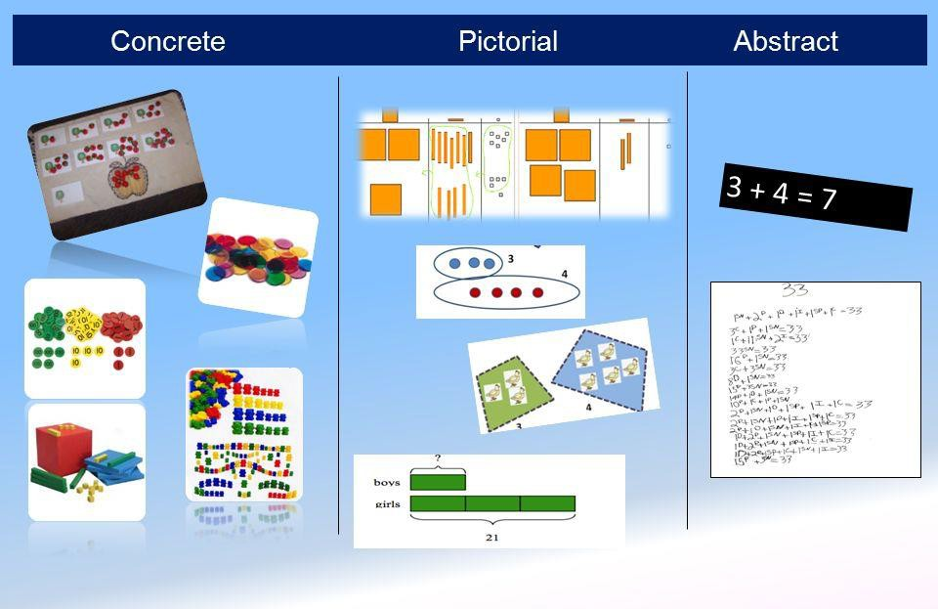
CPA
Children (and adults!) can find maths difficult because it is abstract. The CPA approach builds on children’s existing knowledge by introducing abstract concepts in a concrete and tangible way.
It involves moving from concrete materials, to pictorial representations, to abstract symbols and problems.

Slide 12
CPA – CONCRETE STEP
Concrete is the ‘doing stage’. During this stage, children use concrete objects to model and see the maths.
Unlike traditional maths teaching methods where teachers demonstrate how to solve a problem, the CPA approach brings concepts to life by allowing children to experience and handle physical (concrete) objects.
With the CPA framework, every abstract concept is first introduced using physical, interactive concrete materials (Maths No Problem, 2019).
For example, if a problem involves adding paintbrushes, children can first handle paintbrushes. From there, they can progress to handling abstract counters or cubes which represent the paintbrushes.

Slide 13
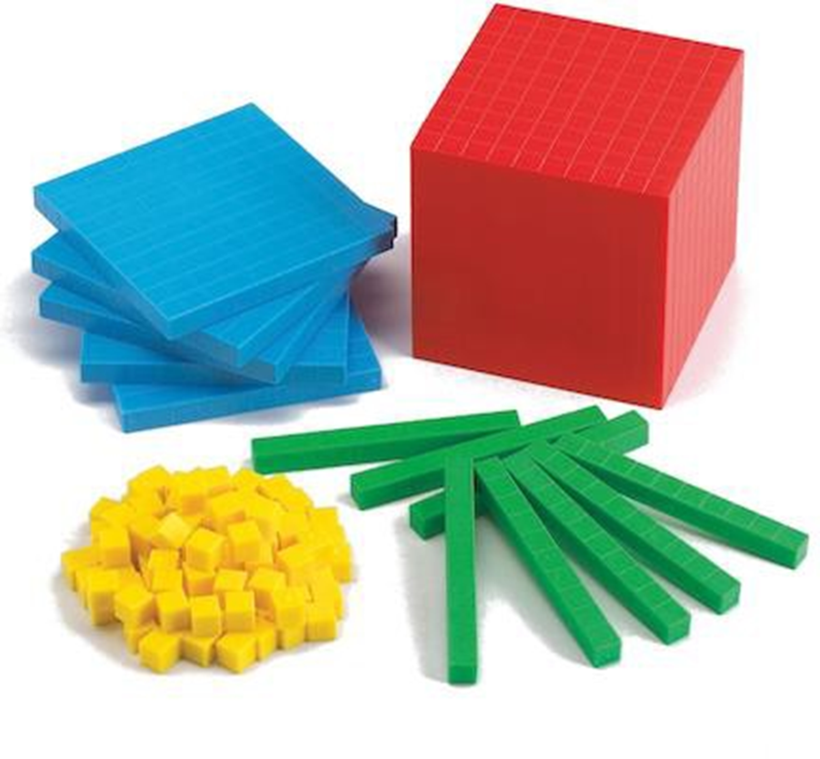
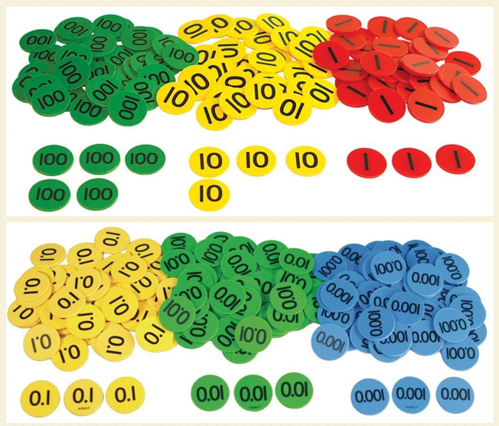
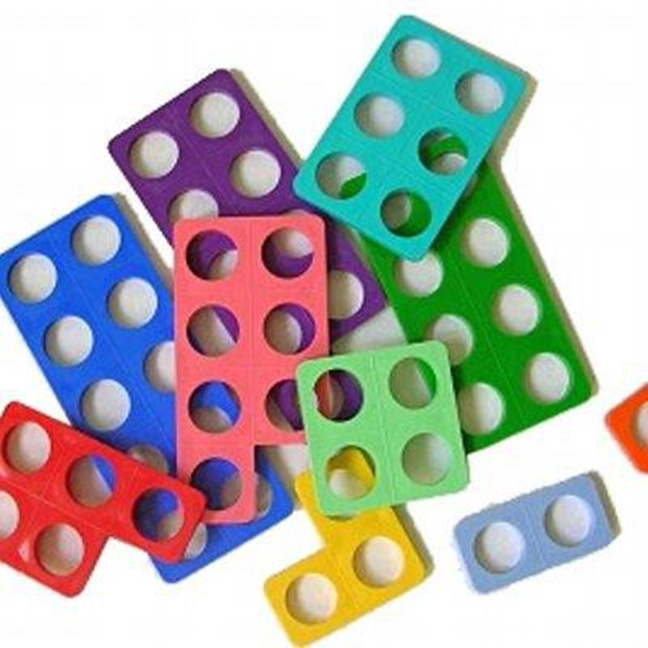
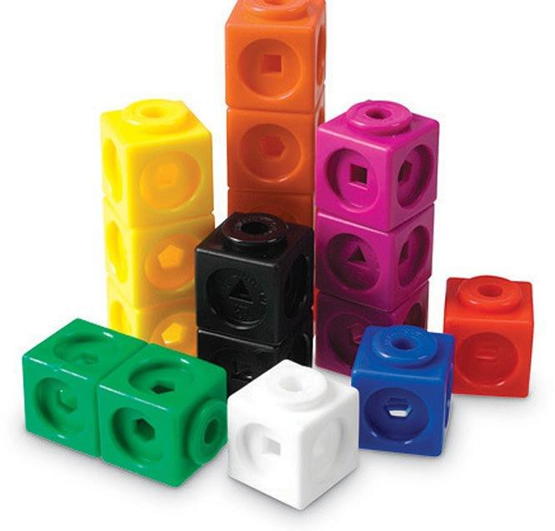
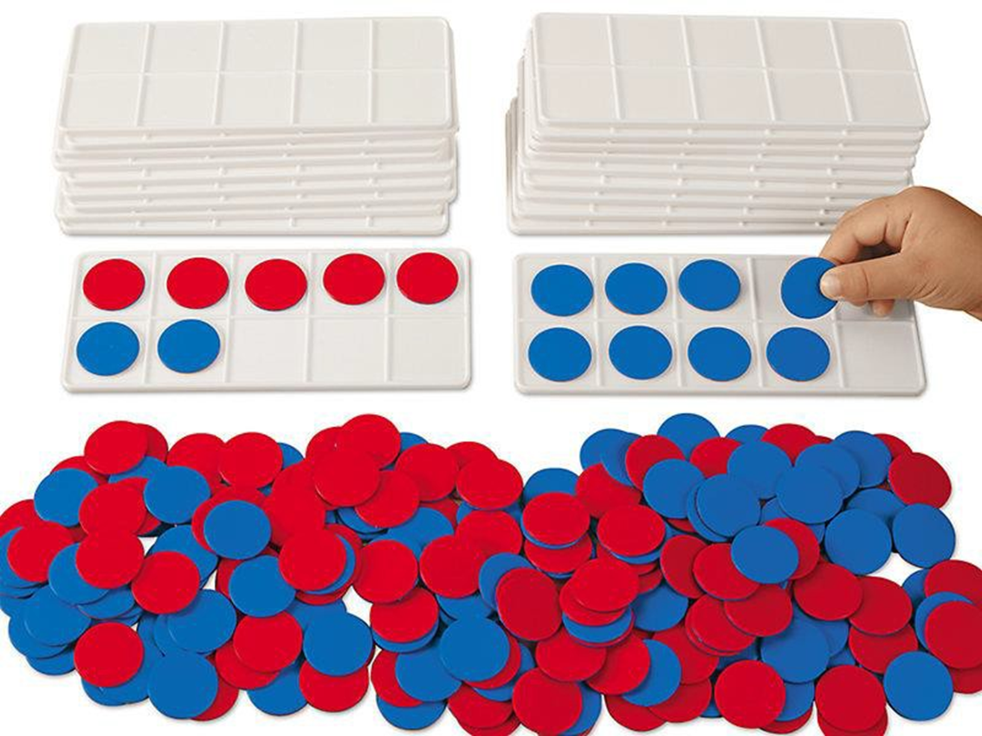
SOME OF THE
CONCRETE RESOURCES THAT WE USE IN
SCHOOL
MULTILINK CUBES
PLACE VALUE COUNTERS
DIENES BASE 10
NUMICON
TENS FRAMES & DOUBLE-SIDED COUNTERS

Slide 14
CPA – PICTORIAL STEP
Pictorial is the ‘seeing’ stage. Here, visual representations of concrete objects are used to model problems. This stage encourages children to make a mental connection between the physical object they just handled and the abstract pictures, diagrams or models that represent the objects from the problem.
Building or drawing a model makes it easier for children to grasp difficult abstract concepts (e.g. fractions). Simply put, it helps the children visualise abstract problems and makes them more accessible.

Slide 15
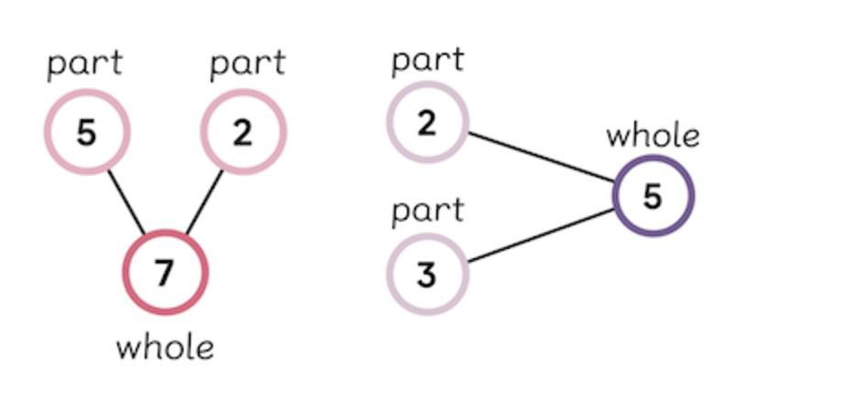
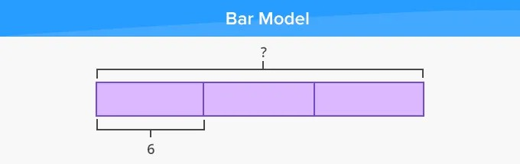
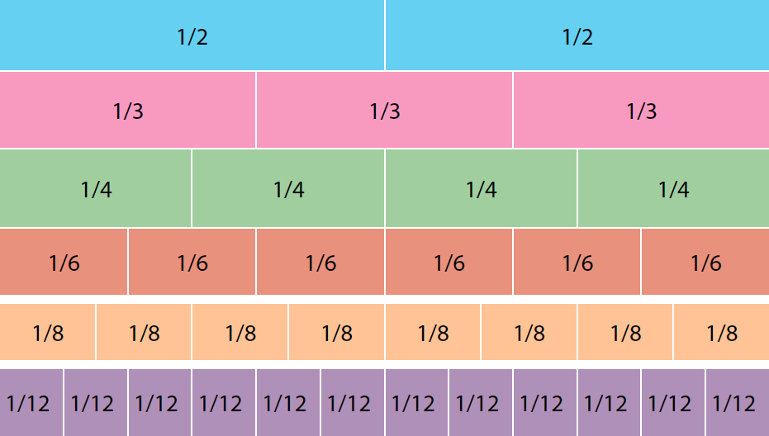
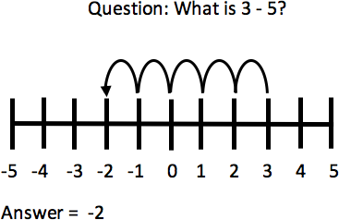
EXAMPLES OF MODELS AND DIAGRAMS
Part-whole model
Number line
Fraction wall

Slide 16
CPA – ABSTRACT STEP
Abstract is the ‘symbolic’ stage, where children use abstract symbols to model problems. They will not progress solely to this stage until they have demonstrated that they have a solid understanding of the concrete and pictorial stages of the problem.
The abstract stage involves the teacher introducing abstract concepts (e.g. mathematical symbols). Children are introduced to the concept at a symbolic level, using only numbers, notation, and mathematical symbols
(e.g. +, -, x, /) to indicate addition, subtraction, multiplication or division.

Slide 17
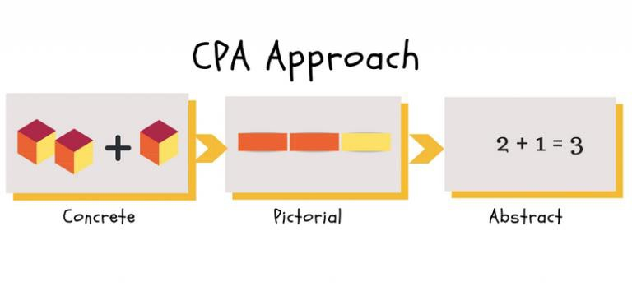
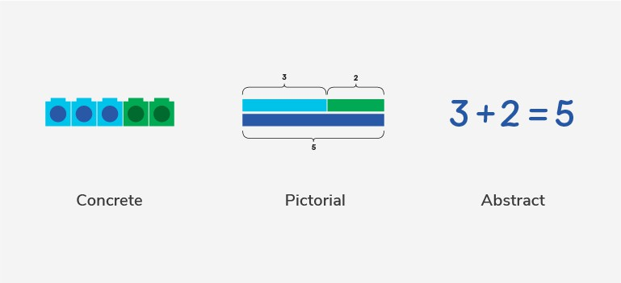
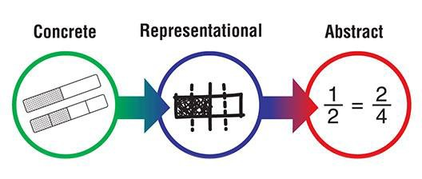
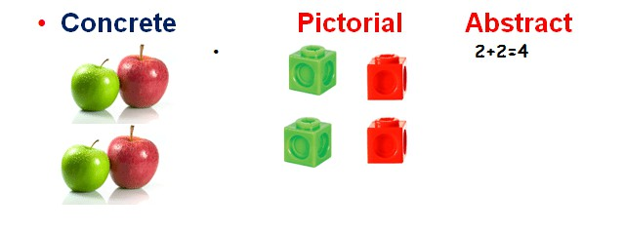
ALTHOUGH WE’VE OUTLINED CPA AS THREE DISTINCT STAGES, THE TEACHERS WILL GO BACK AND FORTH BETWEEN EACH STAGE TO REINFORCE CONCEPTS.

Slide 18
Addition and Subtraction: The learning trajectory
 | Year
A | 1
B | 1
C | 1
D | 2
E | 2
F | 2
G | 3
H | 3
I | 3
J | 6
K | 6
 | Year
A
B
C
D
E
F
G
H
I
J
K
Composition of number
Introducing an equation with small numbers
Drawing out structures of addition and subtraction
Calculating and crossing the tens boundary
The structure of difference
Calculating with two-digit numbers
Calculating complements to 100
Understand commutativity and the inverse relationship
Add and subtract up to three-digit numbers using columnar methods
Calculate using knowledge of structures (EQUAL DIFFERENCE…)
Manipulate equations to solve problems (NOTICING…)
(SUBITISING)

Slide 19
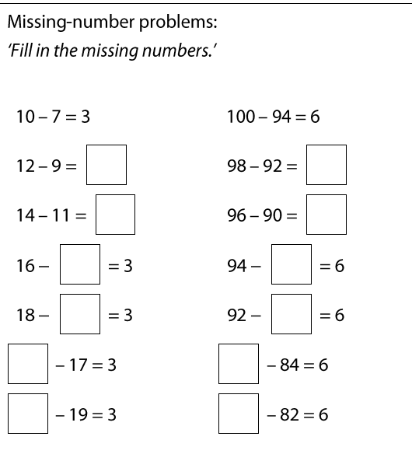
Intelligent practice
What would you want the children
to do or notice?
What would you not want them to do?

Slide 20
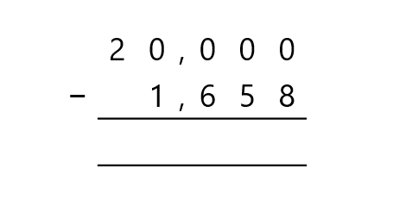
19, 999
1, 657
_________
-
________
1658
20,000

Slide 21
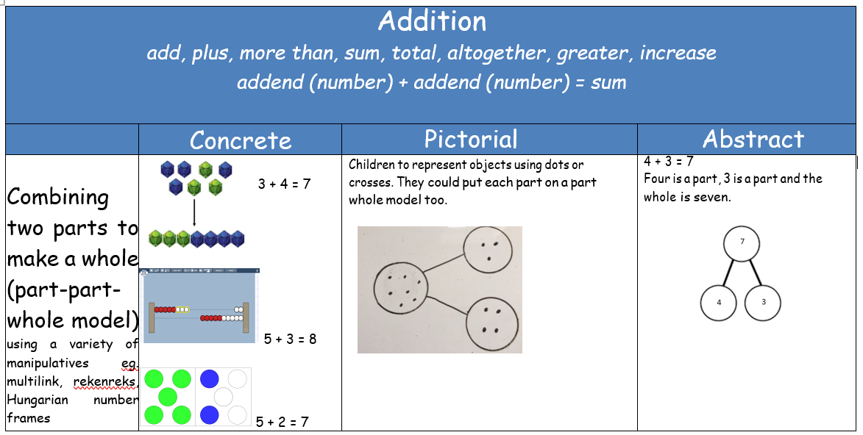
aggregation

Slide 22
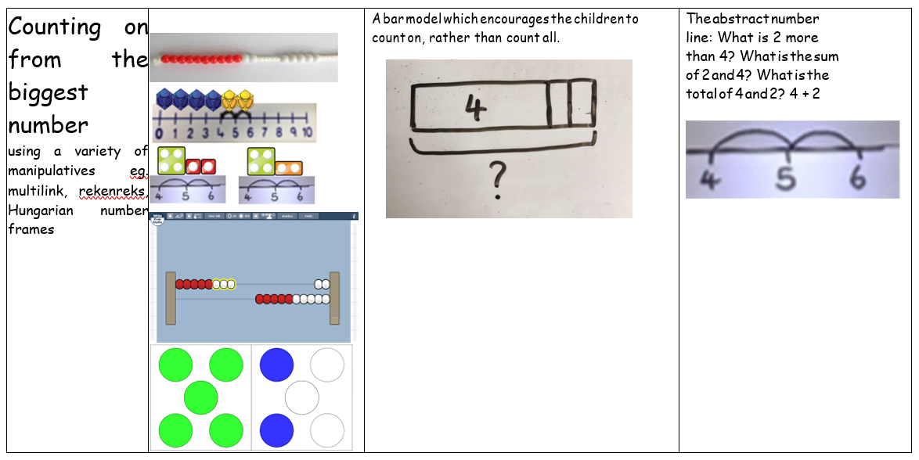
augmentation

Slide 23
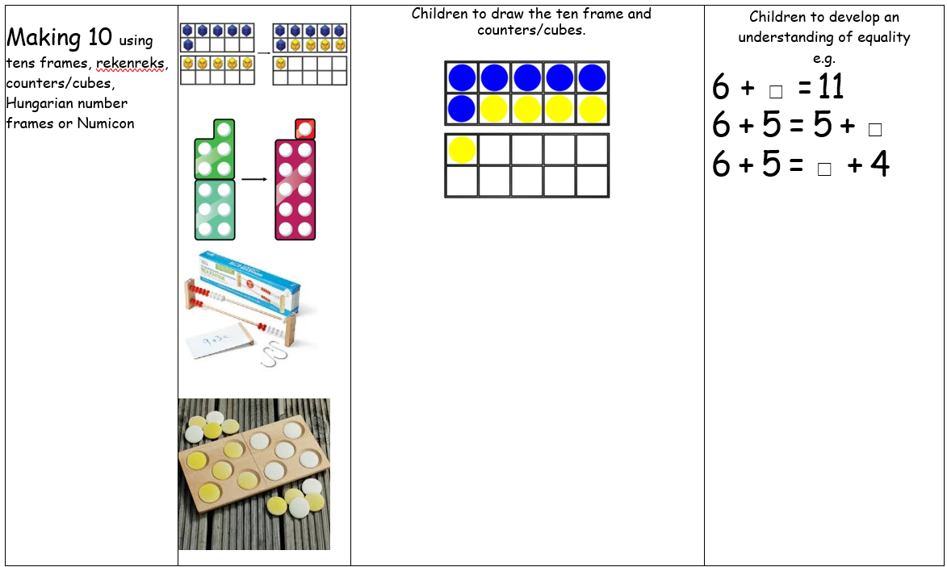
bridging 10
automaticity vs derivation

Slide 24
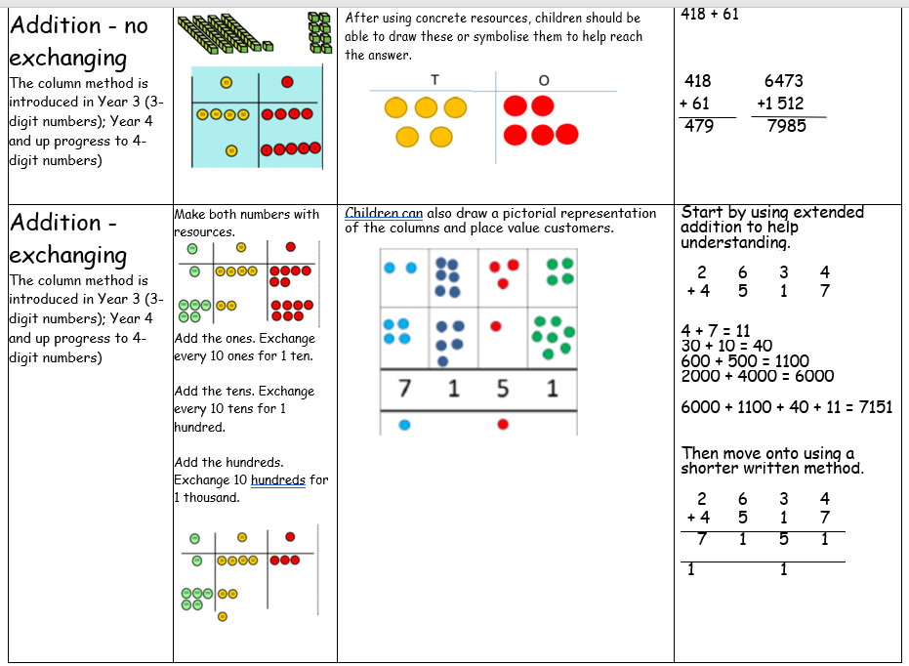

Slide 25
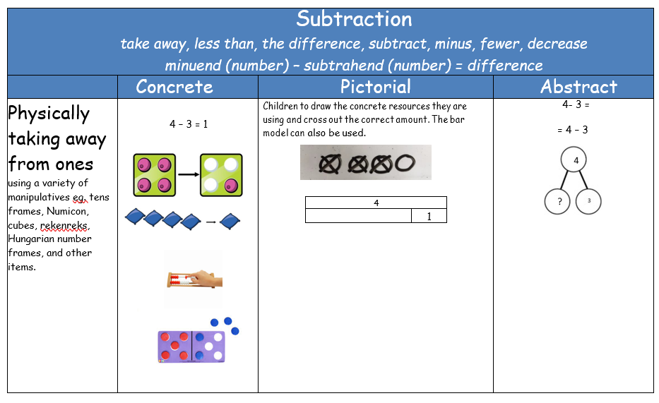
partition/decomposition/ reduction

Slide 26
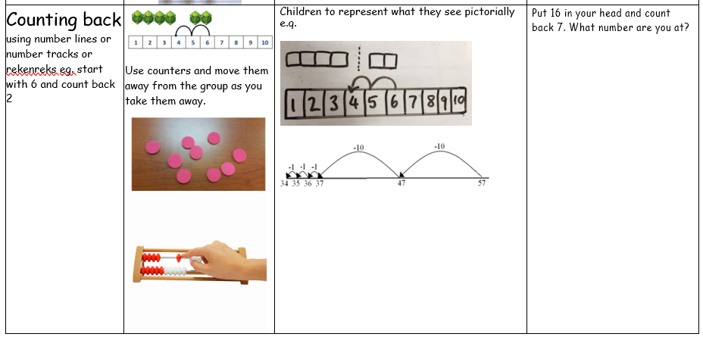

Slide 27
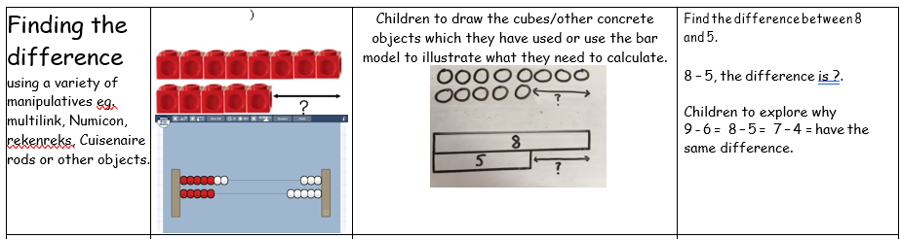
difference

Slide 28
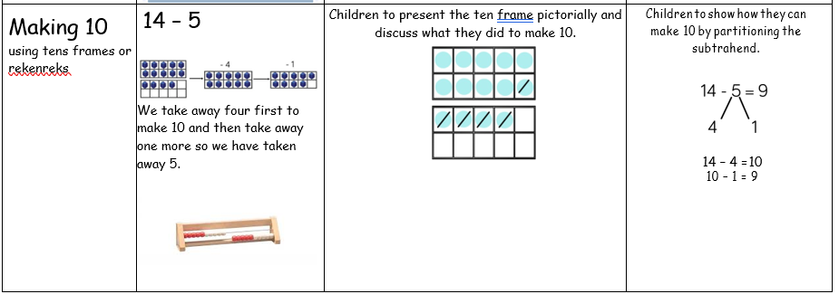
inverse
bridging 10
automaticity vs derivation

Slide 29
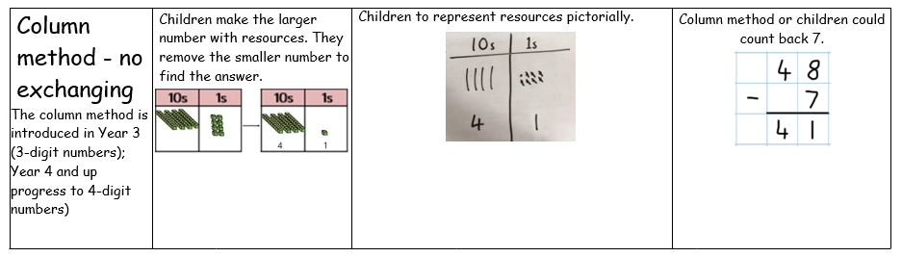

Slide 30
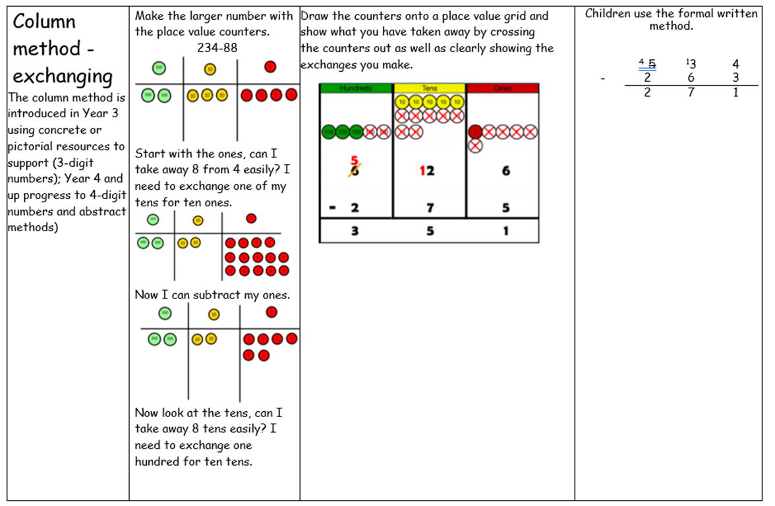
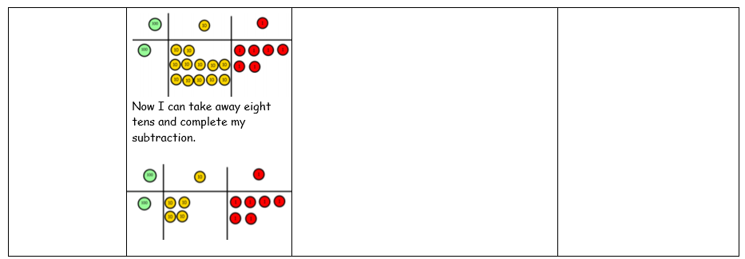

Slide 31
Classroom Visits
Please start in Reception if you have a child in that class and also wish to visit other classrooms. Reception’s Maths sessions are short!
There is approximately 20 minutes to visit the classrooms before the children go out to breaktime at 10.20am.
Please be mindful that the class teacher, and other members of staff in the classroom, remain responsible for the children whilst you are in the classroom.
Please ensure your child remains focused on their learning and on the expectations we have of their behaviours and attitudes whilst in class – which may well be tricky as they will be excited to see you!

