Slide 1


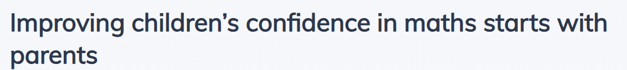
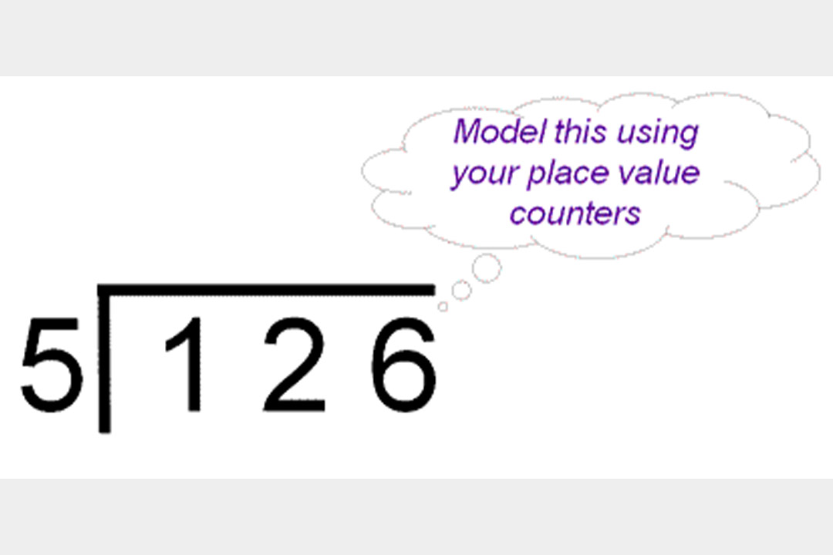
MATHS MASTERY 26.01.26
PARENTS’ MULTIPLICATION AND DIVISION SESSION
(National Centre for Excellence in the Teaching of Mathematics, 2019
https://www.ncetm.org.uk/features/improving-children-s-confidence-in-maths-starts-with-parents/ )
Use place value counters to model what is actually happening in this short division algorithm.
https://www.nationalnumeracy.org.uk/helping-children-maths

Slide 2
THE ESSENCE OF MATHS TEACHING FOR MASTERY
Maths teaching for mastery rejects the idea that a large proportion of people just ‘can’t do maths’.
All pupils are encouraged by the belief that by working hard at maths they can succeed.
Pupils are taught through whole-class interactive teaching, where the focus is on all pupils working together on the same lesson content at the same time. This ensures that all can master concepts before moving to the next part of the curriculum sequence, allowing no pupil to be left behind.

Slide 3
THE ESSENCE OF MATHS TEACHING FOR MASTERY
In a typical lesson pupils the teacher leads back and forth interaction, including questioning, short tasks, explanation, demonstration, and discussion.
Procedural fluency and conceptual understanding (understanding what you are doing and knowing how to do it) are developed in tandem because each support the development of the other.

Slide 4
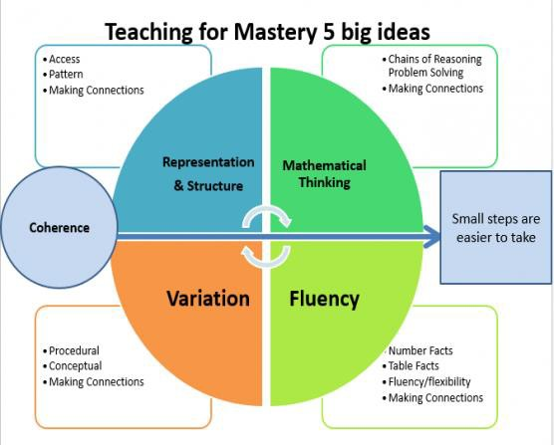
How do we teach Maths Mastery at Ditchling?

Slide 5
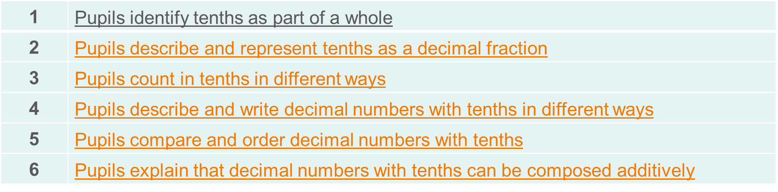
COHERENCE (BIG IDEA 1)
Lessons are broken down into small connected steps that gradually unfold the concept, providing access for all children and leading to a generalisation of the concept and the ability to apply the concept to a range of contexts (NCETM, 2019).
We use NCETM materials. The sequence of teaching is on the Maths page of the school website, and is also detailed on the Weekly Update.

Slide 6
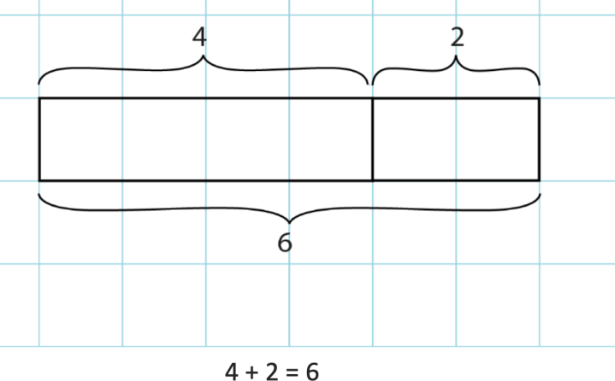
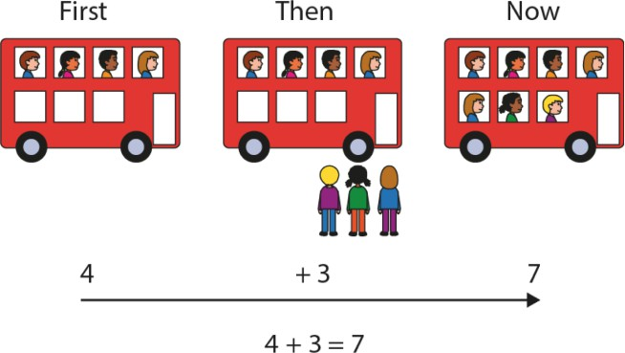
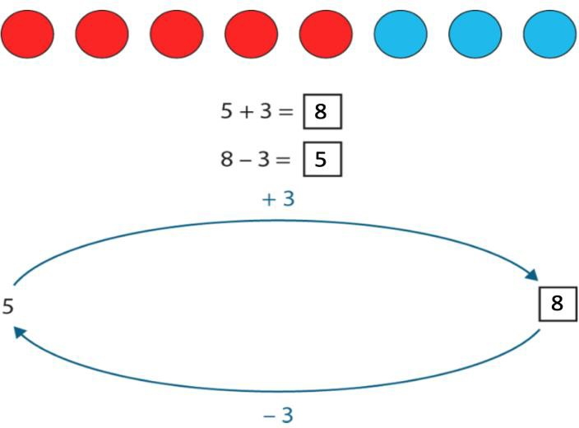
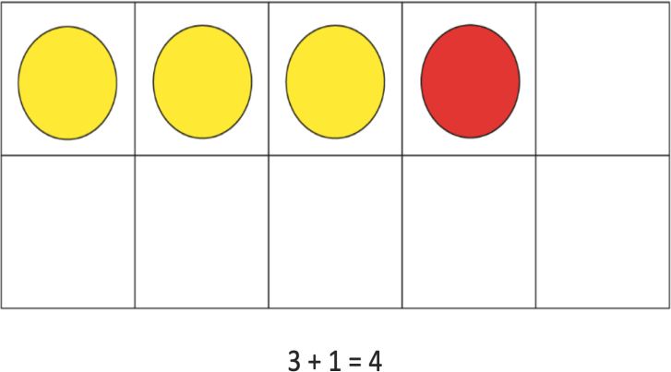
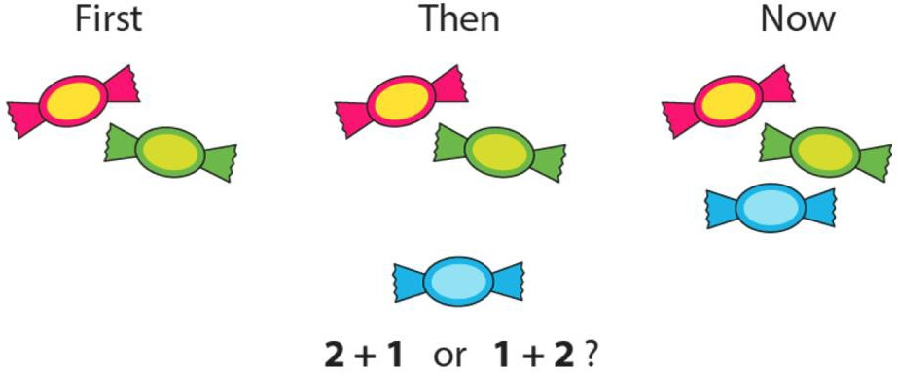
REPRESENTATION AND STRUCTURE (BIG IDEA 2)
Representations used in lessons expose the mathematical structure being taught, the aim being that students can do the maths without recourse to the representation (NCETM, 2019).

Slide 7
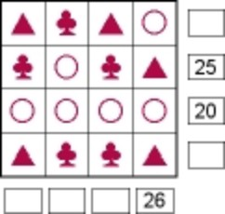
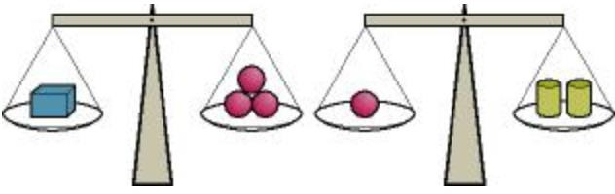
MATHEMATICAL THINKING (BIG IDEA 3)
If taught ideas are to be understood deeply, they must not merely be passively received but must be worked on by the student: thought about, reasoned with and discussed with others (NCETM, 2019).
Each shape stands for a number. The numbers shown are the totals of the line of four numbers in the row or column. Find the remaining totals.
From the information shown on the scales, can you work out which object weighs the least?

Slide 8
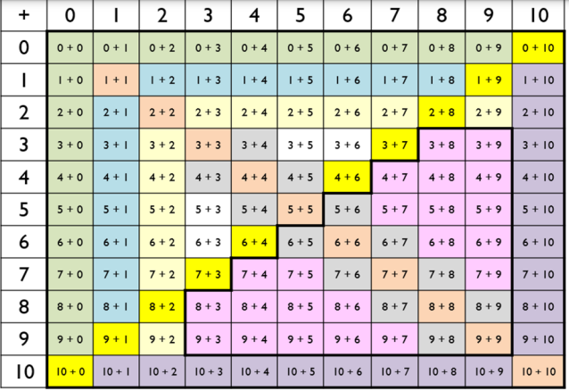
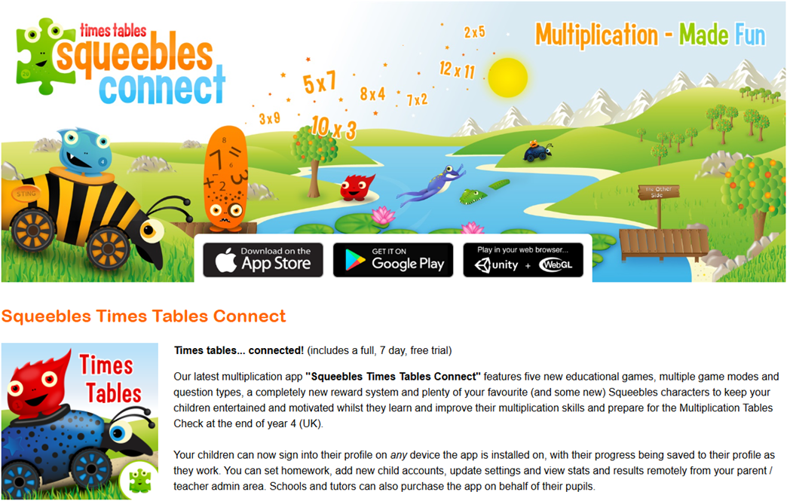

FLUENCY (BIG IDEA 4)
Quick and efficient recall of facts and procedures and the flexibility to move between different contexts and representations of mathematics (NCETM, 2019).
The National Curriculum states that pupils should become fluent in the fundamentals of mathematics through varied and frequent practice. While a part of this is about knowing key mathematical facts and recalling them efficiently, fluency means so much more than this.
Fluency gives pupils the ability to delve deeper into maths; to develop number sense and choose the most appropriate method for the task at hand; to be able to apply a skill to multiple contexts (Third Space Learning, 2019).

Slide 9

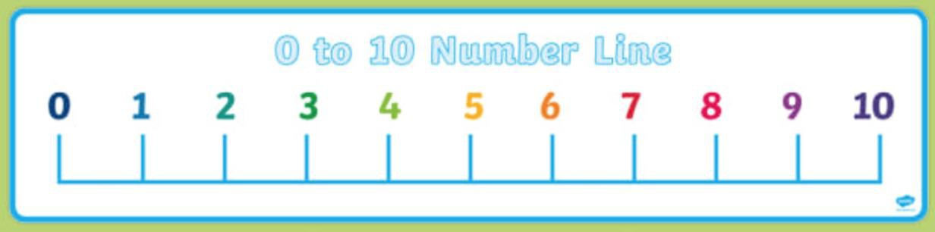
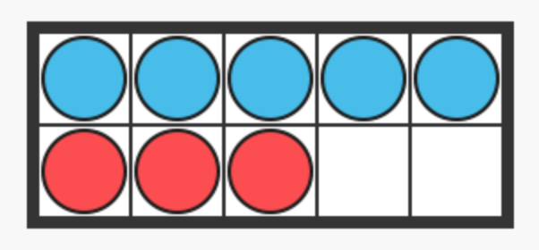
VARIATION (BIG IDEA 5)
Variation is twofold. It is firstly about how the teacher represents the concept being taught, often in more than one way, to draw attention to critical aspects, and to develop deep and holistic understanding. It is also about the sequencing of the episodes, activities and exercises used within a lesson and follow up practice, paying attention to what is kept the same and what changes, to connect the mathematics and draw attention to mathematical relationships and structure (NCETM, 2019).
There are 3 red flowers and 5 blue flowers. How many flowers are there altogether?
There are 8 flowers; some are red and some are blue. If three of them are red, how many are blue?
There are 8 flowers; some are red and some are blue. If there are two more blue flowers than red flowers, how many are there of each colour?

Slide 10

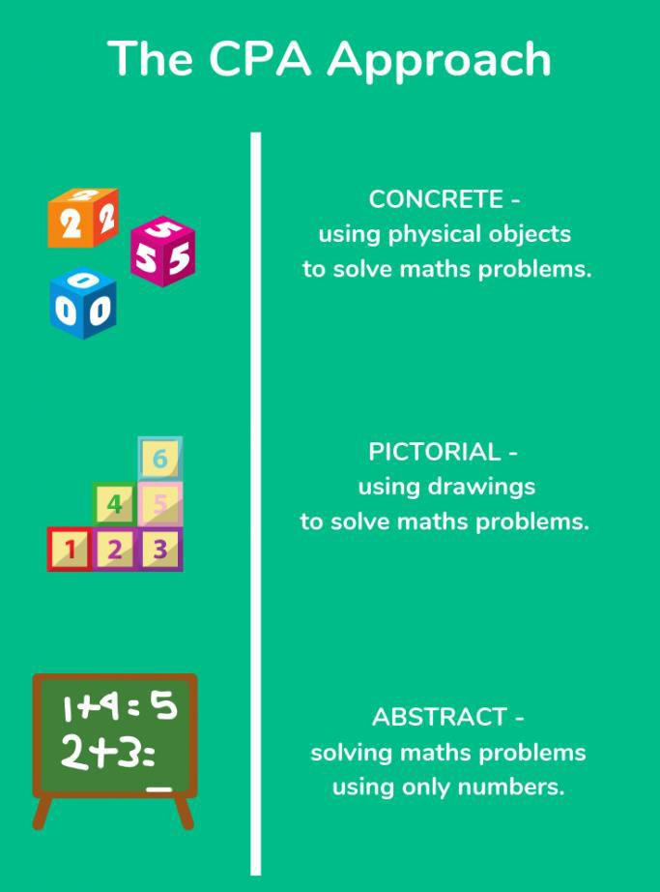
ANOTHER ASPECT OF MASTERY: CONCRETE – PICTORIAL – ABSTRACT
Concrete, Pictorial, Abstract (CPA) is a highly effective approach to teaching that develops a deep and sustainable understanding of maths in pupils.
CPA was developed by American psychologist, Jerome Bruner. It is an essential technique within maths mastery teaching.
This approach is used from Reception through to Year 6.

Slide 11
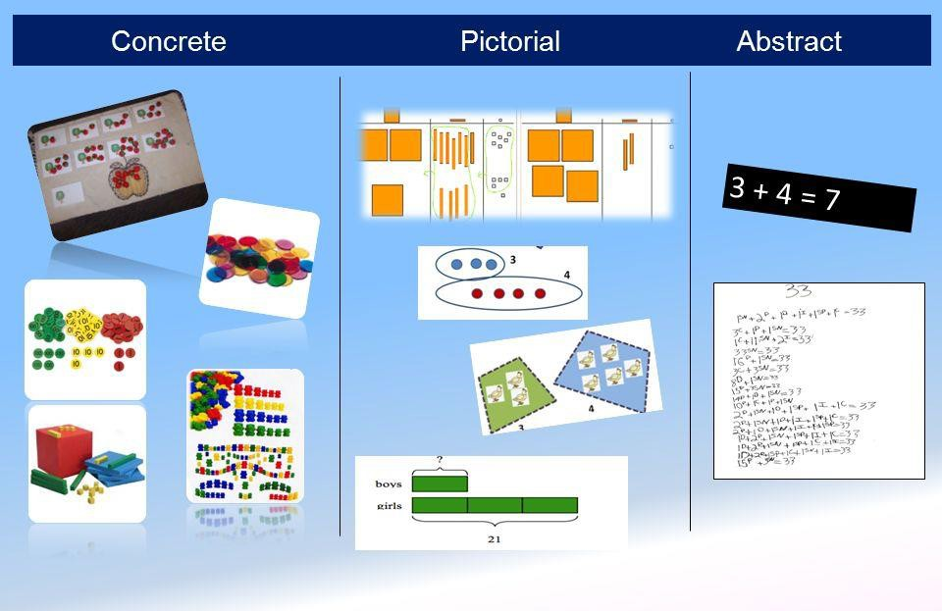
CPA
Children (and adults!) can find maths difficult because it is abstract. The CPA approach builds on children’s existing knowledge by introducing abstract concepts in a concrete and tangible way.
It involves moving from concrete materials, to pictorial representations, to abstract symbols and problems.

Slide 12
CPA – CONCRETE STEP
Concrete is the ‘doing stage’. During this stage, children use concrete objects to model and see the maths.
Unlike traditional maths teaching methods where teachers demonstrate how to solve a problem, the CPA approach brings concepts to life by allowing children to experience and handle physical (concrete) objects.
With the CPA framework, every abstract concept is first introduced using physical, interactive concrete materials (Maths No Problem, 2019).
For example, if a problem involves adding paintbrushes, children can first handle paintbrushes. From there, they can progress to handling abstract counters or cubes which represent the paintbrushes.

Slide 13
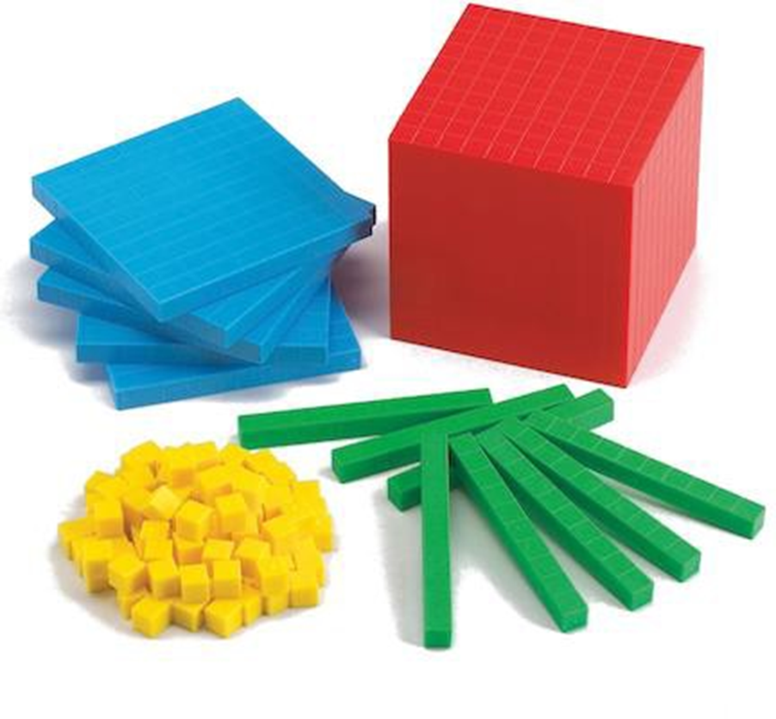
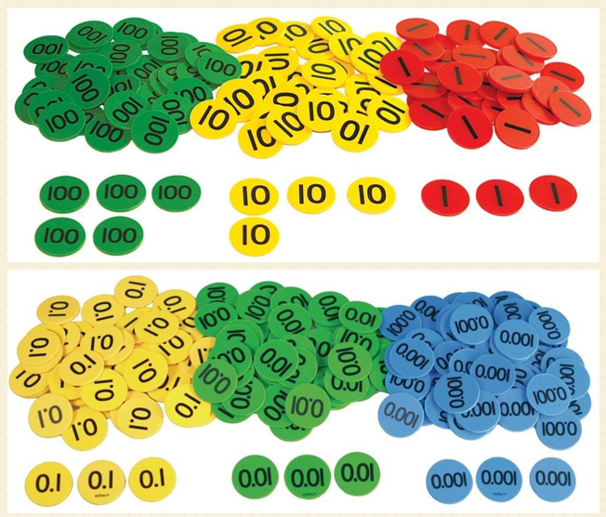
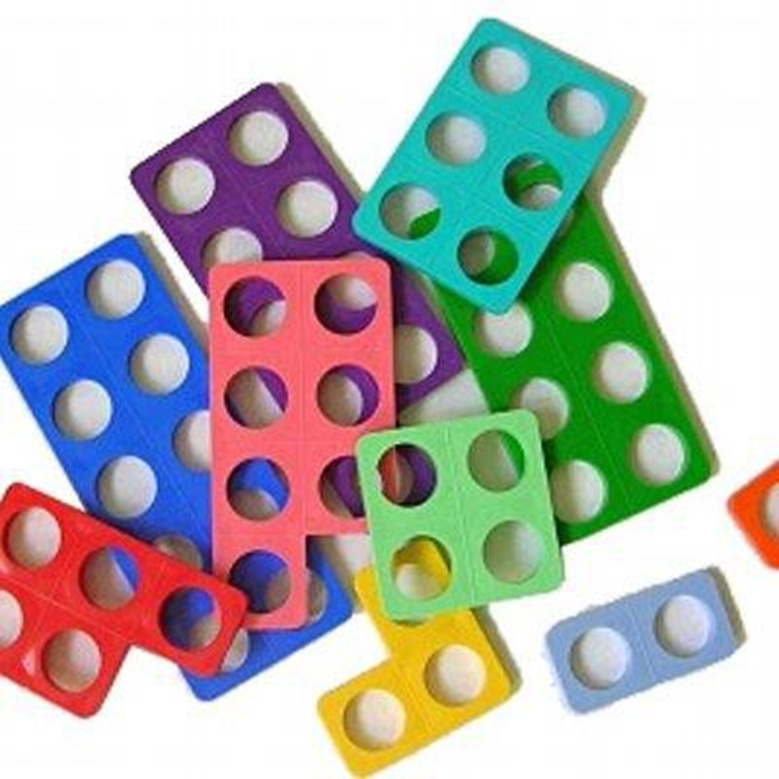
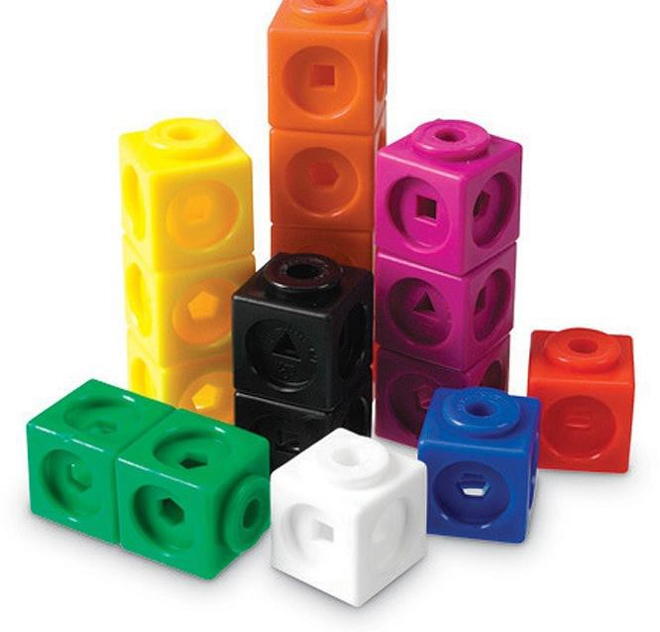
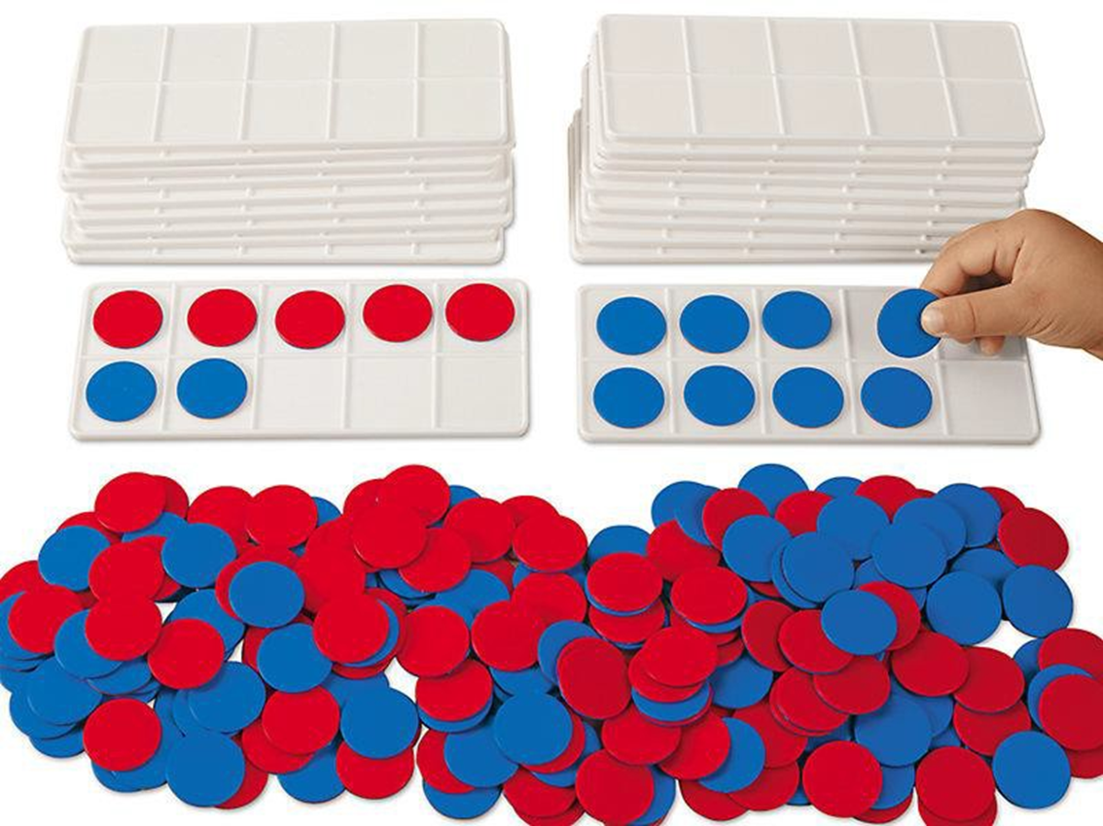
SOME OF THE
CONCRETE RESOURCES THAT WE USE IN
SCHOOL
MULTILINK CUBES
PLACE VALUE COUNTERS
DIENES BASE 10
NUMICON
TENS FRAMES & DOUBLE-SIDED COUNTERS

Slide 14
CPA – PICTORIAL STEP
Pictorial is the ‘seeing’ stage. Here, visual representations of concrete objects are used to model problems. This stage encourages children to make a mental connection between the physical object they just handled and the abstract pictures, diagrams or models that represent the objects from the problem.
Building or drawing a model makes it easier for children to grasp difficult abstract concepts (e.g. fractions). Simply put, it helps the children visualise abstract problems and makes them more accessible.

Slide 15
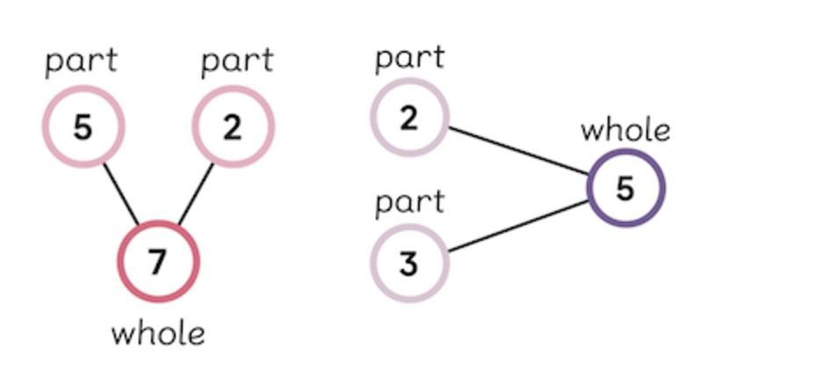
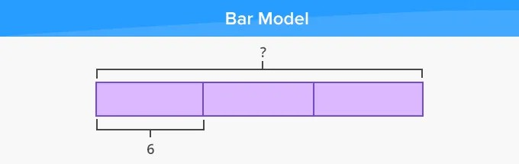
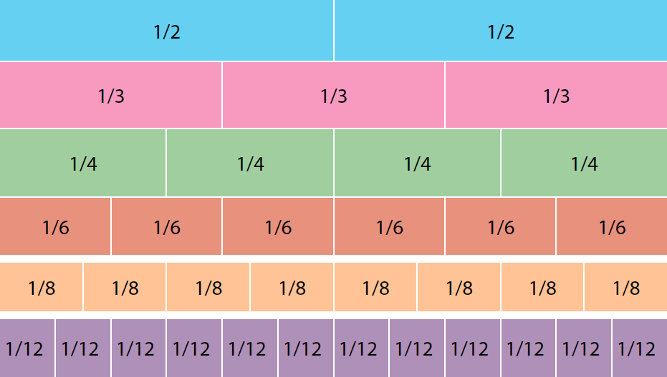
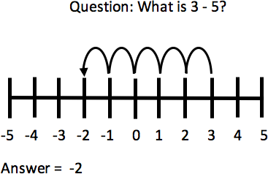
EXAMPLES OF MODELS AND DIAGRAMS
Part-whole model
Number line
Fraction wall

Slide 16
CPA – ABSTRACT STEP
Abstract is the ‘symbolic’ stage, where children use abstract symbols to model problems. They will not progress solely to this stage until they have demonstrated that they have a solid understanding of the concrete and pictorial stages of the problem.
The abstract stage involves the teacher introducing abstract concepts (e.g. mathematical symbols). Children are introduced to the concept at a symbolic level, using only numbers, notation, and mathematical symbols
(e.g. +, -, x, /) to indicate addition, subtraction, multiplication or division.

Slide 17
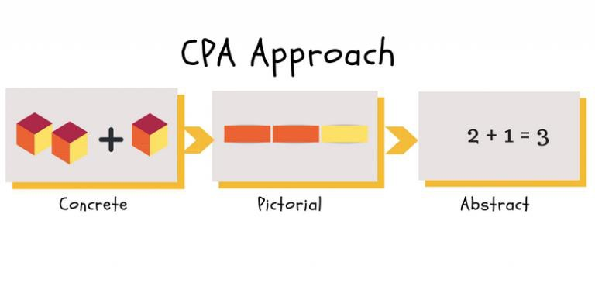
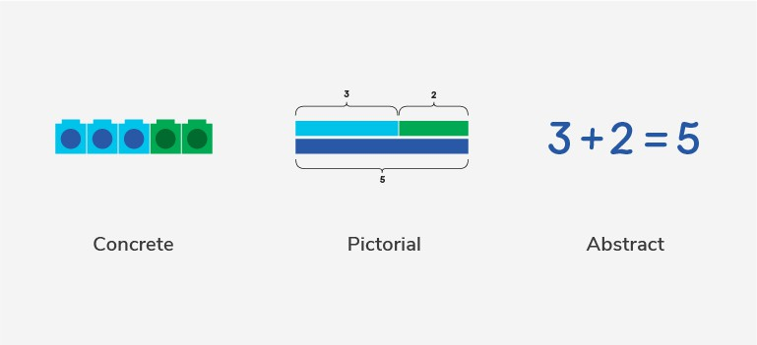
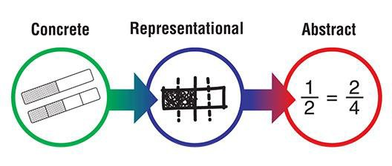
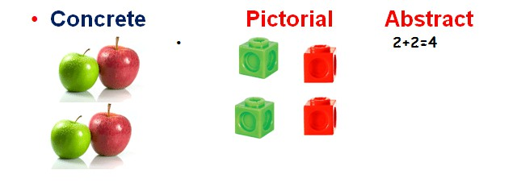
ALTHOUGH WE’VE OUTLINED CPA AS THREE DISTINCT STAGES, THE TEACHERS WILL GO BACK AND FORTH BETWEEN EACH STAGE TO REINFORCE CONCEPTS.

Slide 18
Multiplicative Reasoning
In forming the concept of multiplication, there are three stages of learning.
First, being able to consider many as one, such as one group, one class and one basket of things. Unitising.
Second, being able to imagine several many-as-one units, such as several groups, classes or baskets of things (all of the same size).
Third, when analysing quantitative relationships, being able to manage the two types of units at the same time.
In human history, there is a long gap between the development of addition and the development of multiplication. For students, there is also a gap. One task of school arithmetic is to give students a pathway across that gap.
Source: Ma and Kessel, in Building the Foundation: Whole Numbers in the Primary Grades. (Reprinted from University of Chicago School Maths Project) p 453
Notes:
“In teaching, multiplication is often introduced with repeated addition. When students see 4 + 4 + 4 as ‘4 added to 4, added to 4’, they are using the concept of addition. When students can recognise 4 + 4 + 4 as three 4s, they start to develop the concept of multiplication. We should help students to accomplish this transition as soon as possible. Although it is likely that the concept of addition is closely related to an inborn primitive conception, the concept of multiplication is not.”
Same book page 452
In this book it refers to many-as-one - the unit represents more than one

Slide 19
The learning trajectory
 | Year
A | 2
B | 2
C | 2
D | 3
E | 3
F | 4
G | 4
H | 4
I | 4
J | 4
K | 4
L | 5
M | 5
N | 5
O | 5
P | 6
Q | 6
 | Year
A
B
C
D
E
F
G
H
I
J
K
L
M
N
O
P
Q
Introduction to multiplication: unitising, equal groups and repeated addition
Write equations and calculate using the 2,5,10 times table
Introduction to the division structures of partitive and quotitive division
Recall 2, 4, 8 times table
Apply times tables (2, 5, 10, 4, 8) to solve contextual problems
3, 6, 9 times tables
7 times table and patterns
Divide 1,000 into 2, 4, 5 and 10 equal parts, and read scales
Multiply and divide whole numbers by 10 and 100
Understand and apply the distributive property of multiplication
Understand and apply the commutative property of multiplication
Short column methods for multiplication and division
Calculation: ×/÷ decimal fractions by whole numbers
Factors, multiples and primes
Divide and interpret remainders appropriately for the context.
Use knowledge of multiplicative structures to derive calculations
Long multiplication and division
Complete the grid with the appropriate year group

Slide 20

Unitising
Represent this situation using some of the resources on your table:
“There are 4 apples in a bag. I buy 3 bags of apples.”
Fosnott and Dolk:
In order to reason multiplicatively, children need to be able to ‘unitise’ (treat a group as a single entity).
There are 5 children in each team. How many children are taking part in this competition?
Notes:
Most will represent with 3 groups of 4 counters but draw out that they could use 3 counters, each one representing a bag of 4 apples.
This is picked up on in the initial Unit of Spine 2 in looking at coin values and the fact that 1 coin can have a value other than 1
This is a concept and representation used in the spine for the times tables – counters with dots on so that we are counting in groups of and not always using individual objects
Then discuss how Y1 children would solve the exercise at the bottom. We have found that children who automatically choose to count in 5s (unitise), vs those who count in 1s , are much better prepared to access multiplicative problems.

Slide 21
Moving to the abstract
Begin by using concrete or pictorial representations, linking the stem sentence:
‘There are ___ groups of ___.’
to the addition and then the multiplication expression:
___ + ___
___ × ___
The group size in the multiplication expression is the second factor.

Slide 22
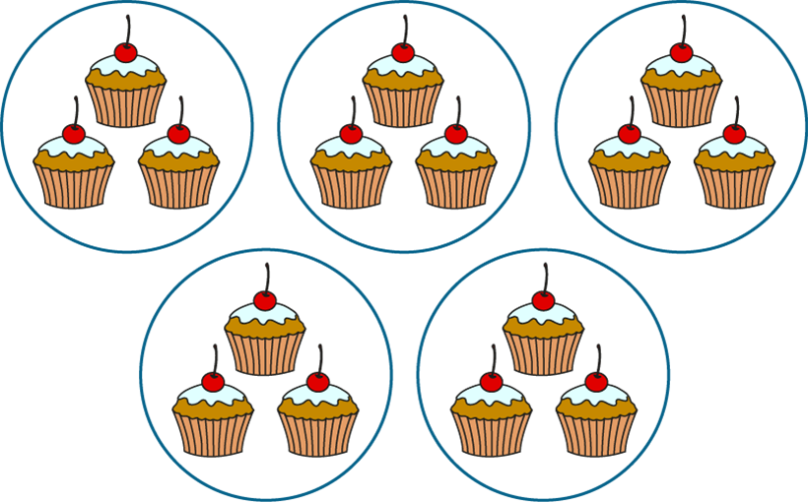
2.2 Multiplication: equal groups Step 2:1
unitising, equal groups and repeated addition
Notes:
Now practise in pairs – one ask the question and the other responds
How many equal groups are there?
How many cakes are there in each group?
There are five equal groups of cakes.
There are three cakes in each group.
There are five groups of three.

Slide 23

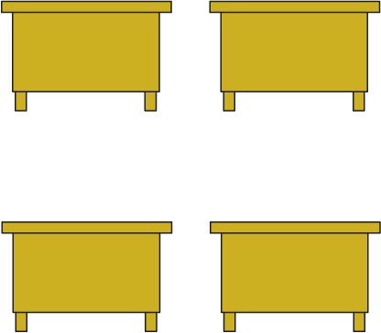
2.2 Multiplication: equal groups Step 5:1
2
2
0
0
2
2
0
0
2 + 2 + 2 + 2
0 + 0 + 0 + 0
4 × 2
4 × 0

Slide 24
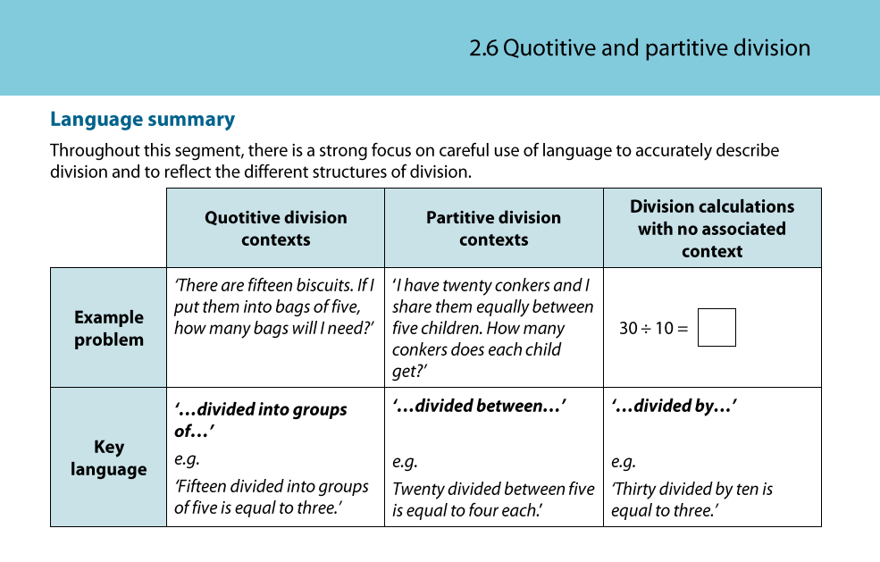
division structures of partitive and quotitive division
Notes:
https://www.ncetm.org.uk/media/e3gpoxwb/ncetm_spine2_segment06_y2.pdf
In the PD materials on the NCETM website there are the spine materials that support with subject knowledge. This has been taken from segment 2.6 –year 2 colleagues might be more familiar with this than KS2 teachers
It is a useful summary of language that supports with the structures of division.
https://www.ncetm.org.uk/media/e3gpoxwb/ncetm_spine2_segment06_y2.pdf

Slide 25
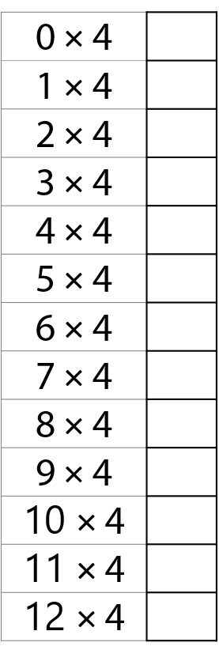



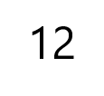
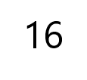
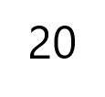
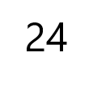
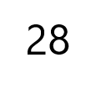
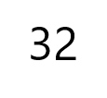
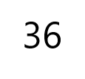
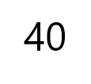
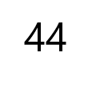
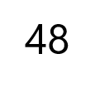
2.7 The 2, 4 and 8 times tables Step 1:9
recall
NB:
Multiplication Tables Check in Y4
Where is it most effective to start?
0, 1
10, 5
11, 9, 12
2, 4, 8
3, 6
7

Slide 26
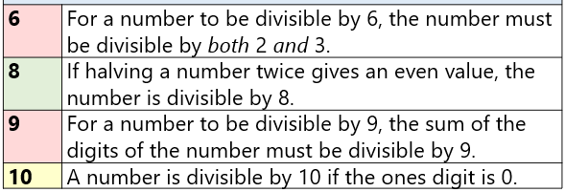
Divisibility rules in numerical order
2 | A number is divisible by 2 if the ones digit is even.
3 | For a number to be divisible by 3, the sum of the digits of the number must be divisible by 3.
4 | If halving a number gives an even value, then the number is divisible by 4. and For numbers with more than two digits: if the final two digits are divisible by 4 then the number is divisible by 4.
5 | A number is divisible by 5 if the ones digit is 5 or 0.
factors, multiples and primes

Slide 27
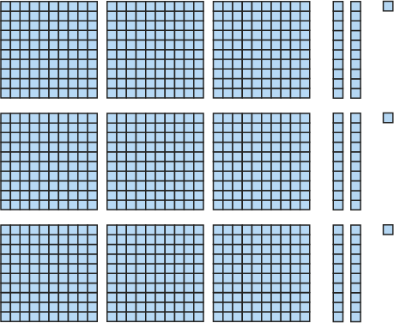
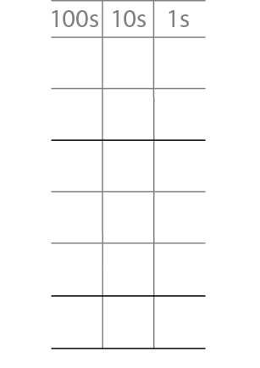
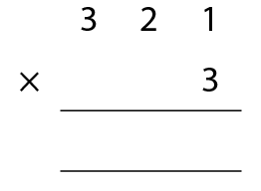
5MD-3 Multiply using a formal written method
methods for multiplication and division
understand and apply the distributive property of multiplication
321 × 3 =
963
3
2
1
×
3
3
3 × 1 ones = 3 ones
6
0
3 × 2 tens = 6 tens
9
0
0
3 × 3 hundreds = 9 hundreds
9
6
3
9
6
3

Slide 28



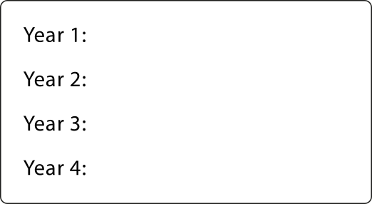
2.15 Short division Step 3:1
methods for multiplication and division
848 pencils shared equally between 4 year groups. How many pencils each?
848 ÷ 4 =
Step 1 – presenting the problem:

Slide 29
Teaching for mastery with a focus on structure
Structural awareness
Structural thinking
Structure of attention
Scaffolding
Attending to the particular through the general, or vice versa
A deep understanding of equivalence and compensation is at the heart of structural thinking
(Mason et al 2009)

Slide 30
6AS/MD-2 Derive related calculations
Use the first calculation to derive the missing term in the second calculation.
Explain your reasoning.
4,800 ÷ 25 = 192
4,800 ÷ 250 =
4,800 ÷ 250 = 19.2

Slide 31
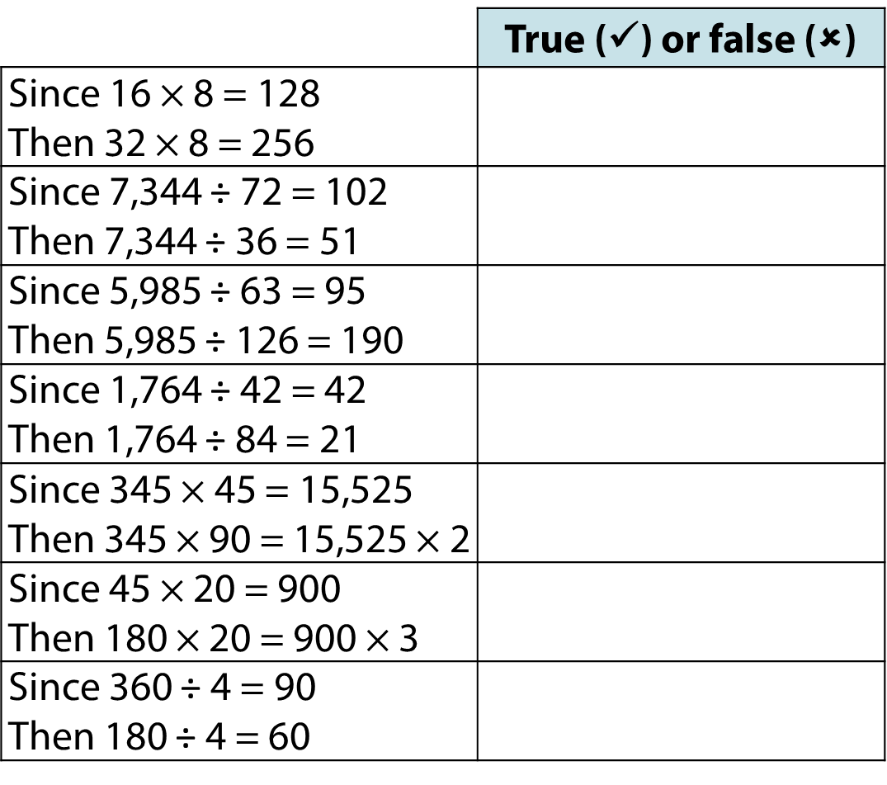
2.25 Compensation Step 3:4
Consider the conceptual understanding that year 6 pupils will bring to this activity. What language will support them to explain their choices?

Slide 32

Calculation Policy

Slide 33

- distributive multiplication

Slide 34


Slide 35

(Concrete)
(Partitive division)
(Quotitive division)

Slide 36

(Pictorial and abstract)

Slide 37


Slide 38


Slide 39
Classroom Visits
Please start in Reception if you have a child in that class and also wish to visit other classrooms. Reception’s Maths sessions are short!
There is approximately 20 minutes to visit the classrooms before the children go out to breaktime at 10.20am.
Please be mindful that the class teacher, and other members of staff in the classroom, remain responsible for the children whilst you are in the classroom.
Please ensure your child remains focused on their learning and on the expectations we have of their behaviours and attitudes whilst in class – which may well be tricky as they will be excited to see you!

